Slide 1
CBRE Hotel Horizons® U.S. Lodging Forecast
Year | ΔGDP | ΔCPI | Occ | ΔOcc | ADR | ΔADR | RevPAR | ΔRevPAR | RevPAR % of 2019
2019 | 2.3% | 1.8% | 66.8% | 0.4% | $129.68 | 0.8% | $86.62 | 1.1% | 100%
2020 | -3.4% | 1.2% | 42.7% | -36.0% | $100.82 | -22.2% | $43.08 | -50.2% | 50%
2021 | 5.7% | 4.7% | 57.4% | 34.6% | $121.57 | 20.6% | $69.90 | 62.2% | 81%
2022 | 2.0% | 7.7% | 62.9% | 9.4% | $143.28 | 17.8% | $90.14 | 29.0% | 104%
2023 | 0.1% | 3.6% | 64.2% | 2.0% | $148.21 | 3.4% | $95.11 | 5.5% | 110%
2024 | 2.6% | 2.7% | 65.9% | 2.7% | $152.08 | 2.6% | $100.26 | 5.4% | 116%
2025 | 2.9% | 2.5% | 66.8% | 1.3% | $155.53 | 2.3% | $103.92 | 3.6% | 120%
Figures in red mark full recovery to 2019 levels.
CBRE Hotels Research 2Q 2022, CBRE EA, Kalibri Labs

Slide 2
U.S. Hotel GOP Margins vs Inflation
GOP as a Percent of Total Operating Revenue vs Change in CPI-U (year-over-year)
CBRE Hotels Research

Slide 3
U.S. Hotel Operating Performance
Dollars Per Available vs Dollar Per Occupied Room
Year-Over-Year Change - YTD June 2022 from YTD June 2021
CBRE Hotels Research

Slide 4
U.S. Hotel Operating Performance – F&B Department
F&B Department Revenues and Expenses - Dollars Per Available Room
Year-Over-Year Change - YTD June 2022 from June 2021
CBRE Hotels Research

Slide 5
U.S. Hotels – Operated Department Expenses
Dollars Per Occupied Room
Monthly Year-Over-Year Change from Same Month of Prior Year
CBRE Hotels Research

Slide 6
U.S. Hotels – Undistributed Department Expenses
Dollars Per Available Room
Monthly Year-Over-Year Change from Same Month of Prior Year
CBRE Hotels Research

Slide 7
U.S. Hotels – Undistributed Department Expenses
Dollars Per Available vs Dollars Per Occupied Room
Year-Over-Year Change - YTD June 2022 from June 2021
CBRE Hotels Research

Slide 8
U.S. Hotels – Utility Expenses
Utility Costs – Dollars Per Available and Occupied Room
Monthly Year-Over-Year Change from Same Month of Prior Year
(%)
CBRE Hotels Research

Slide 9
U.S. Hotel Operating Performance – Labor Costs
Total Labor Costs as a Percent of Total Revenue
Source: CBRE Hotels Research

Slide 10
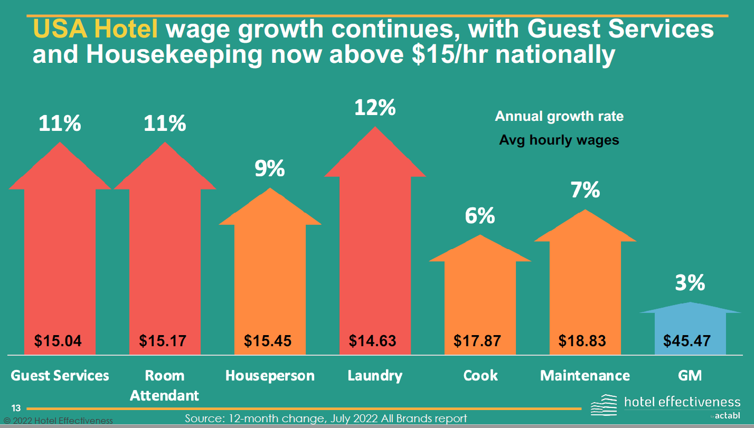
U.S. Hotel Operating Performance – Labor Costs
Wage Rates Continue to Rise in 2022

Slide 11
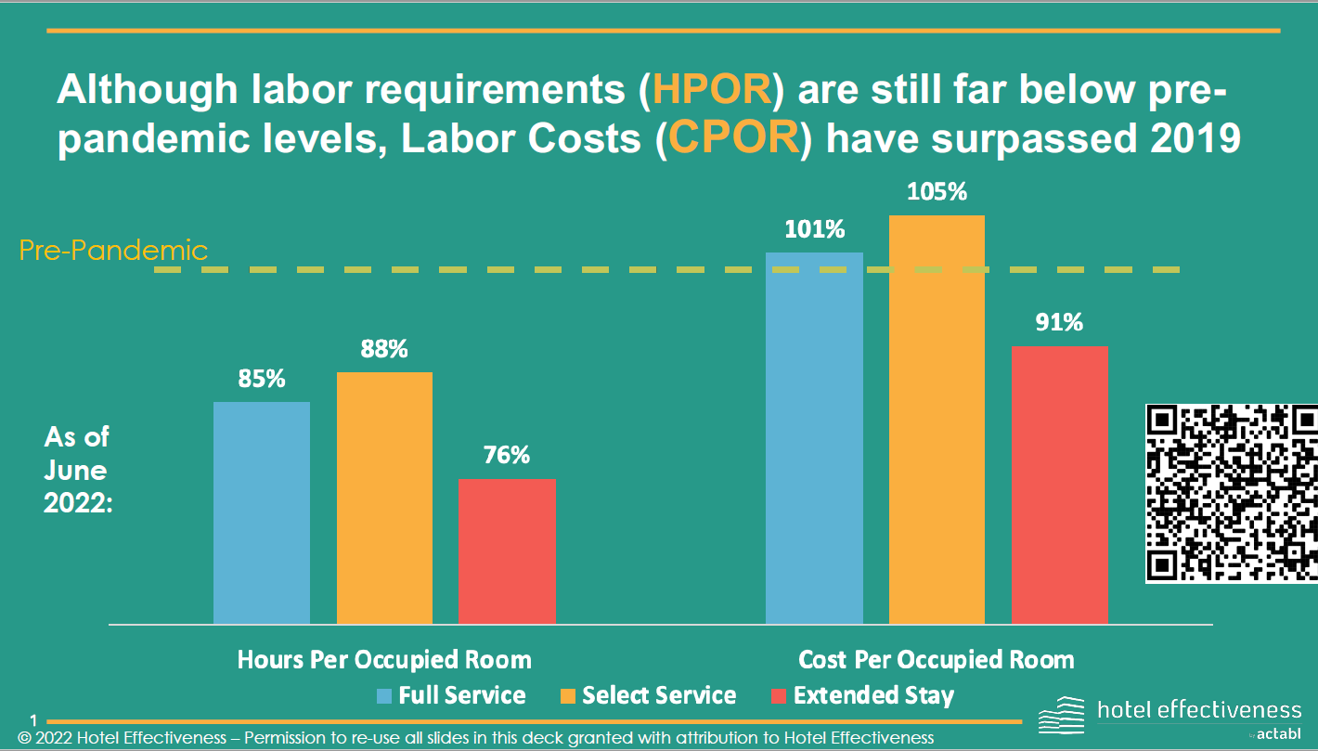
U.S. Hotel Operating Performance – Labor Costs
Reduced Hours Offsetting Increase in Wage Rates

Slide 12
U.S. Hotel Operating Performance – GOP Margins
Percent of Total Operating Revenue
YTD June 2022, YTD June 2021, and YTD June 2019
Source: CBRE Hotels Research

Slide 13
U.S. Hotel Operating Performance – Total Operating Revenue
YTD June 2022 as a Percent of YTD June 2019
Dollars Per Available Room
Source: CBRE Hotels Research

Slide 14
U.S. Hotel Operating Performance – Gross Operating Profit
YTD June 2022 as a Percent of YTD June 2019
Dollars Per Available Room
Source: CBRE Hotels Research

Slide 15
U.S. Lodging Industry – Recession Revenue and Profit Recovery
Total Operating Revenue and GOP – Dollars per Available Room
CBRE Hotels Research

Slide 16
U.S. Lodging Industry – Recession Revenue and Profit Recovery
Years to Recover – Nominal Dollars
CBRE Hotels Research
N/D – No decline

Slide 17
Revenue and Profit Recovery
Total Operating Revenue – Percent of 2019
Gross Operating Profit – Percent of 2019
CBRE Hotels Research, 2Q 2022

Slide 18
U.S. Hotel Operating Performance – Change in GOP Margin
GOP as a Perent of Total Operating Revenue
Source: CBRE Hotels Research

Slide 19
U.S. Hotel Operating Performance – Change in GOP
Annual Nominal and Real Change in GOP per Available Room
CBRE Hotels Research 2Q 2022, BLS

