Slide 1
Kalibri Labs State of the Industry Analysis through Week of August 12th, 2022 Southern Lodging Conference August 24, 2022
Mark V Lomanno
Partner
mark@kalibrilabs.com

Slide 2

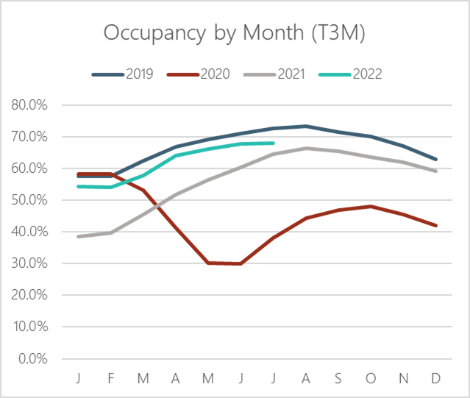
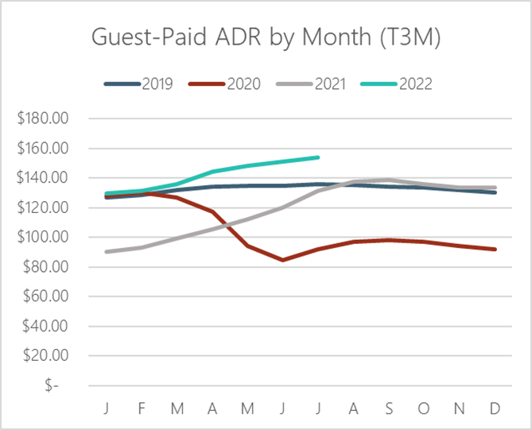
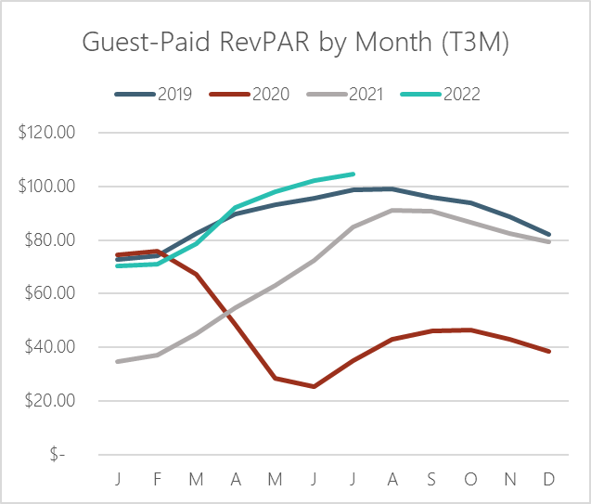
July Occ lags – ADR Remains Strong

Slide 3
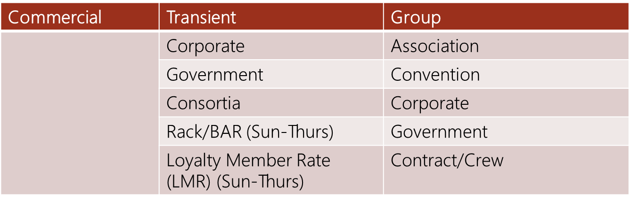
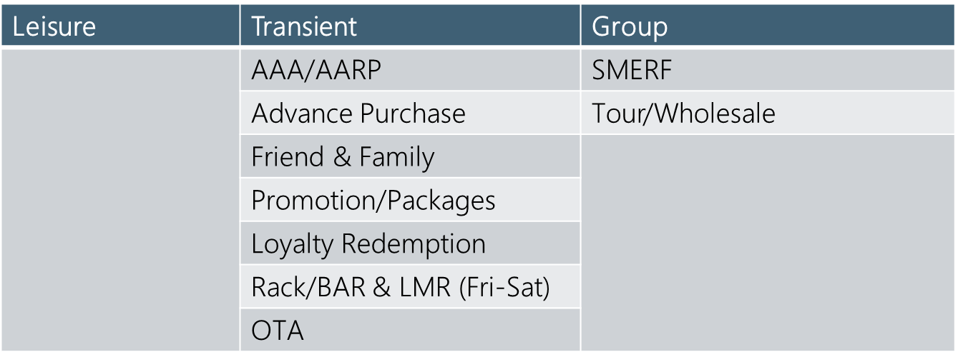
Commercial and Leisure Segment Definition

Slide 4
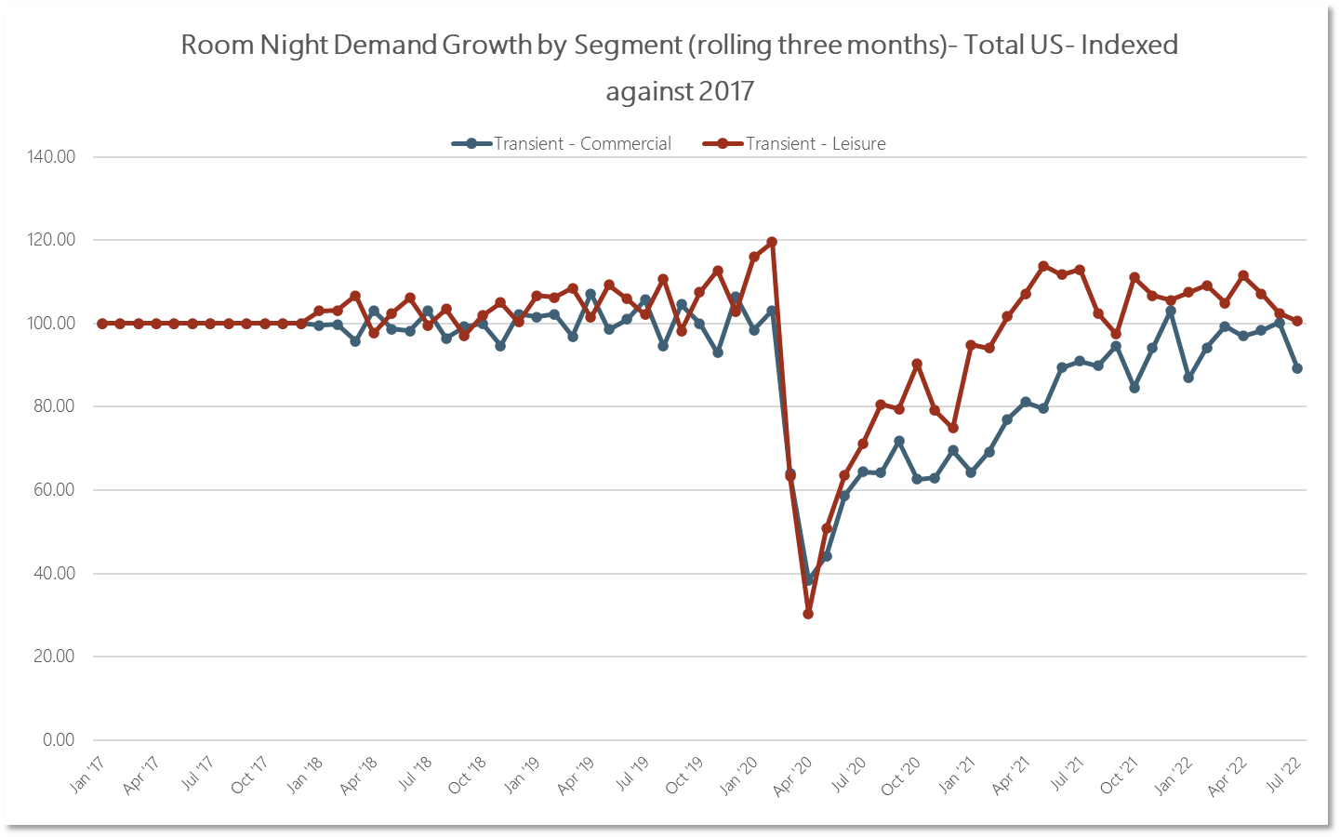
Total U.S. Room Night Demand by Commercial vs. Leisure 2019 – YTD 2022 vs. 2017

Slide 5
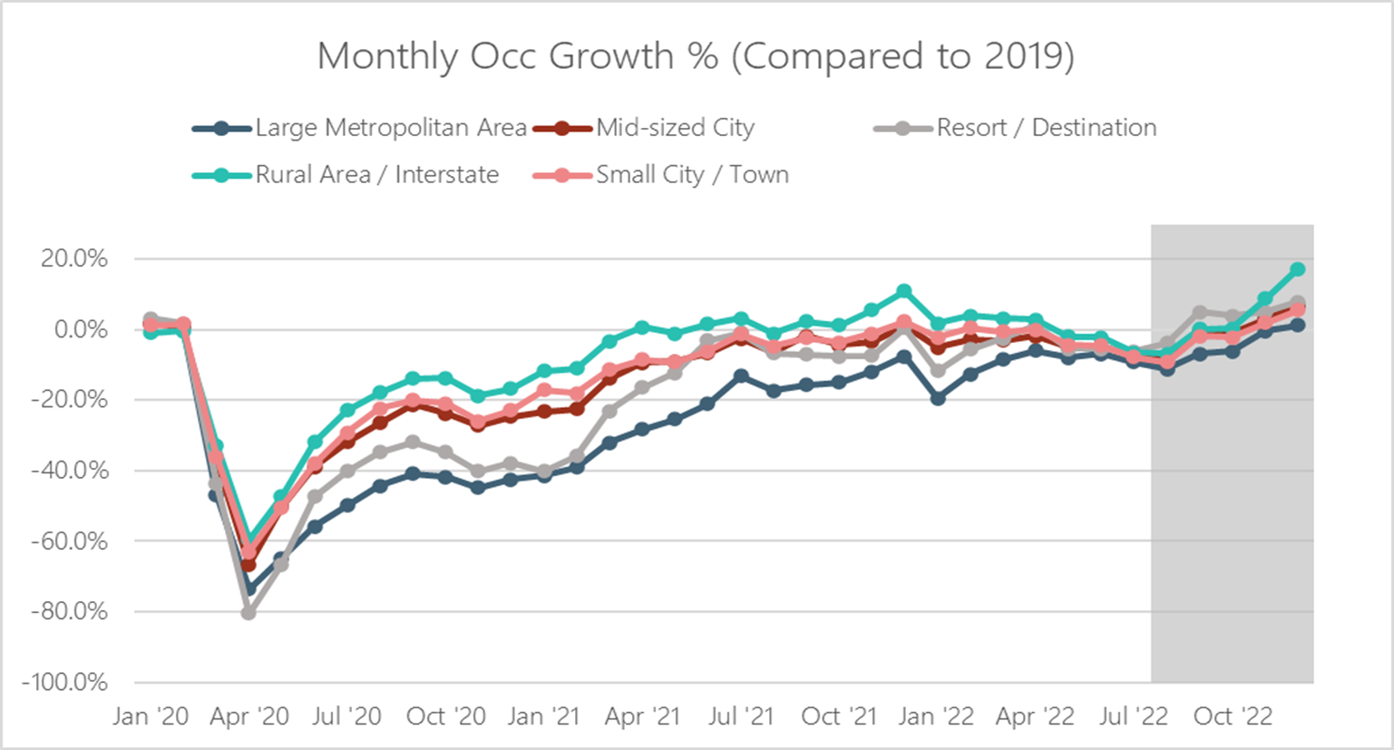
Total U.S. – Occupancy Growth by Market Type January 2020 – 2022(f) vs. 2019
Forecast
Forecast
Forecast

Slide 6
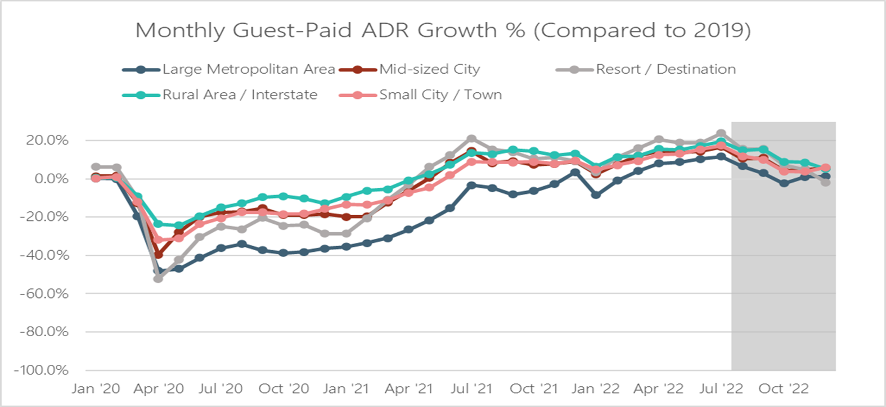
Total U.S. – Guest Paid ADR Growth by Market Type January 2020 – 2022(f) vs. 2019
Forecast

Slide 7
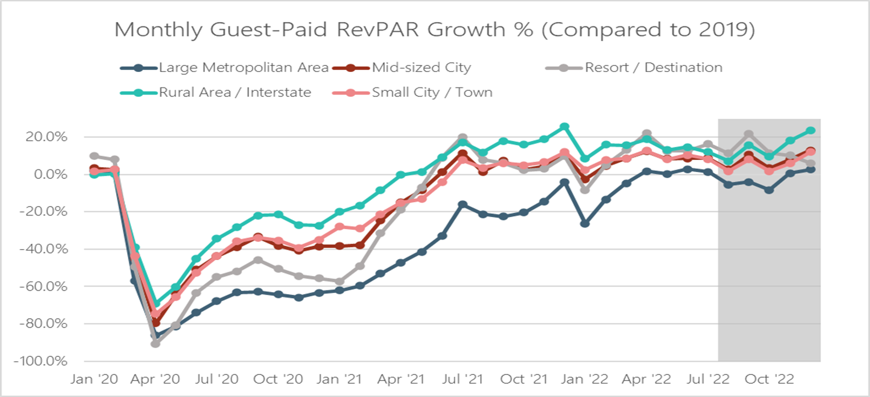
Total U.S. – Guest Paid RevPAR Growth by Market Type January 2020 – 2022(f) vs. 2019
Forecast

Slide 8
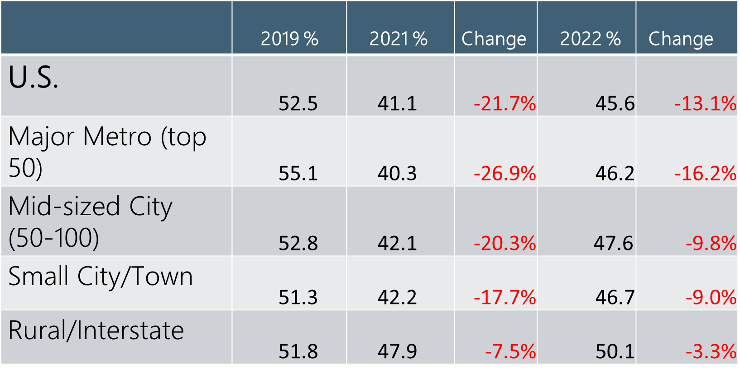
Hotel Performance—Drop in Commercial % Revenue Even when commercial is close to half, decline amount is specific to the market type
© 2021 Kalibri Labs | Reproduction or use is prohibited without prior written approval.

Slide 9
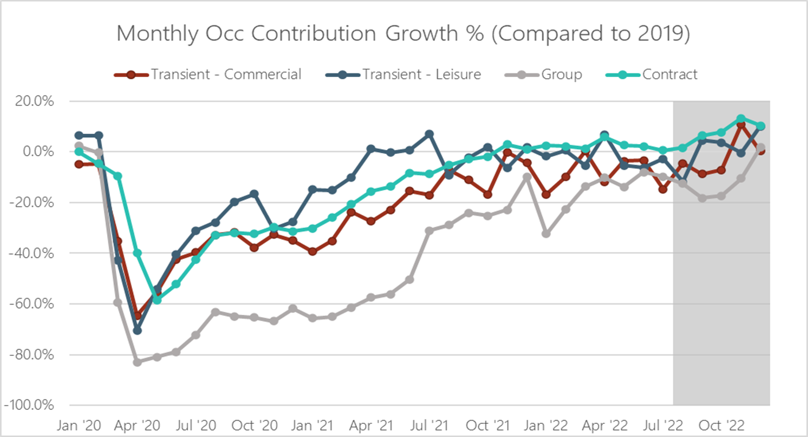
Total U.S. Performance by Major Rate Segments Occupancy Contribution January 2020 – 2022(f) vs. 2019
Forecast

Slide 10
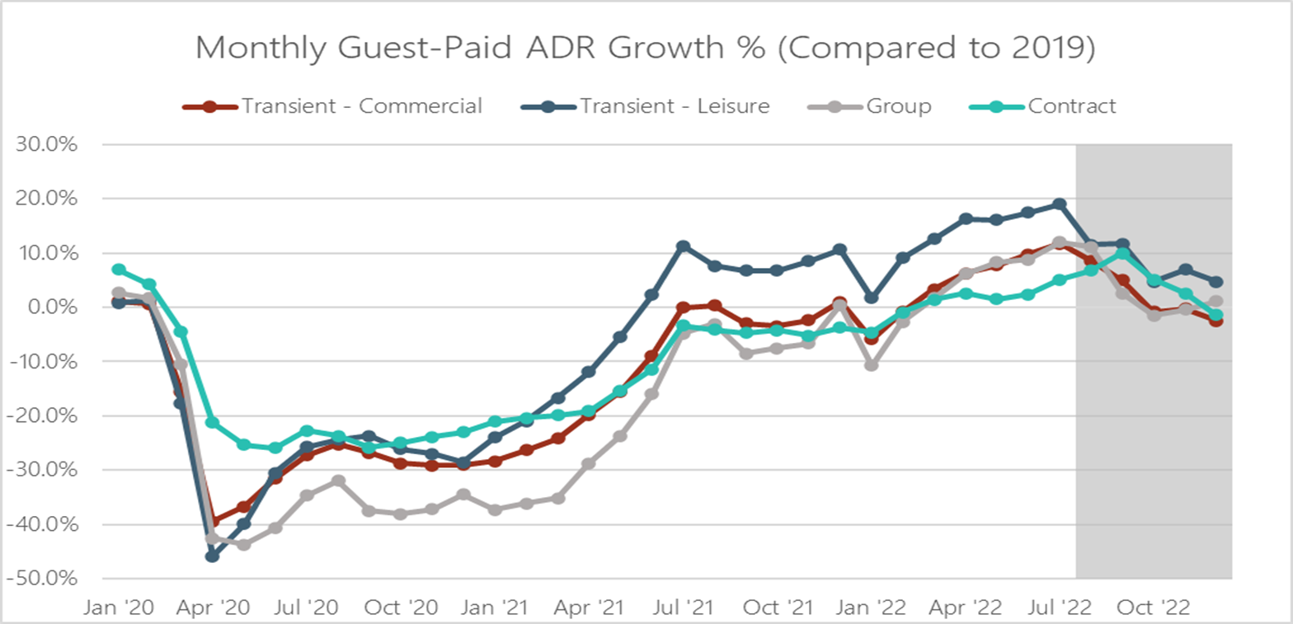
Total U.S. Performance by Major Rate Segments Guest Paid ADR January 2020 – October 2022(f) vs. 2019
Forecast

Slide 11
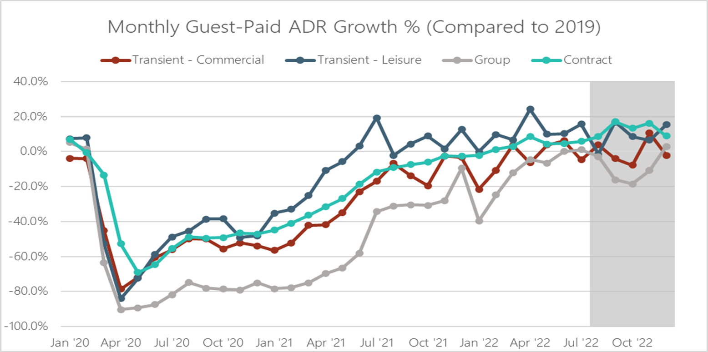
Total U.S. Performance by Major Rate Segments Guest Paid RevPAR January 2020 – October 2022(f) vs. 2019
Forecast

Slide 12
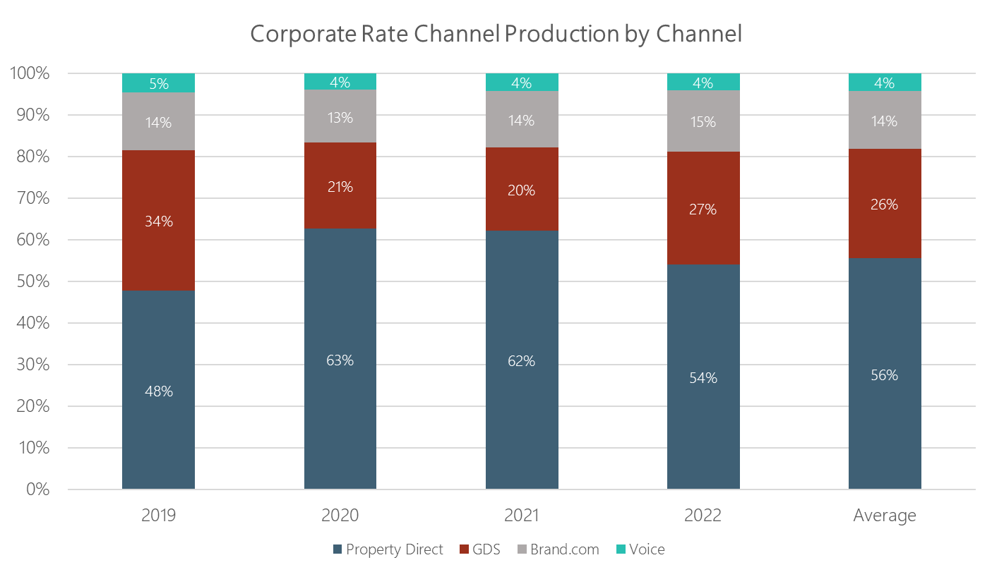
Corporate Rate Category by Channel

Slide 13
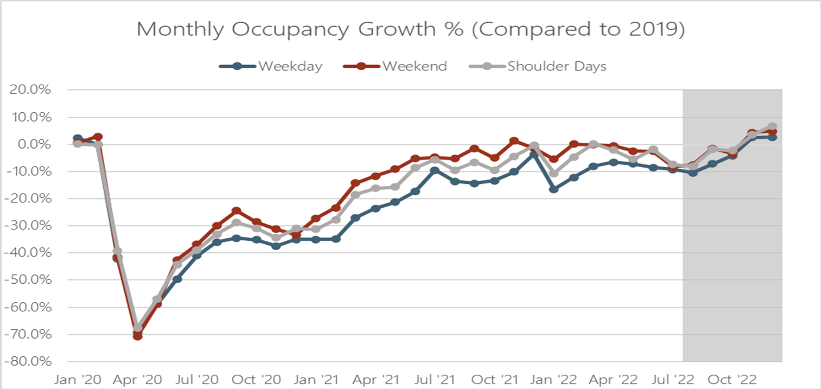
Total U.S. Performance – Occupancy Growth by Weekpart January 2020 – October 2022(f) vs. 2019
Forecast

Slide 14
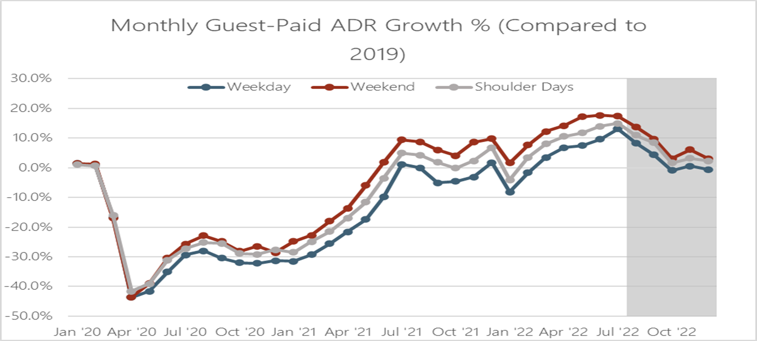
Total U.S. Performance – Guest Paid ADR by Weekpart January 2020 – October 2022(f) vs. 2019
Forecast

Slide 15
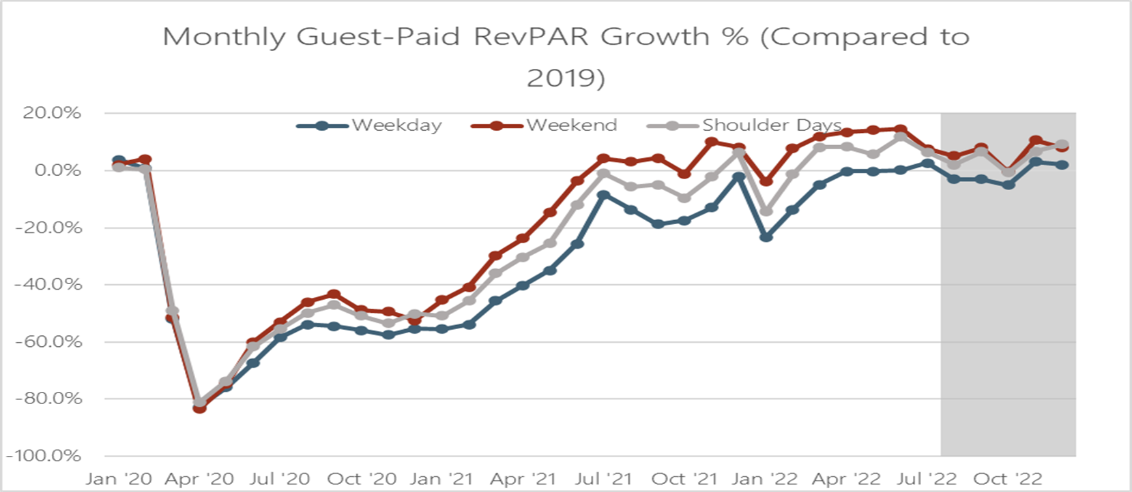
Total U.S. Performance – Guest Paid RevPAR by Weekpart January 2020 – October 2022(f) vs. 2019
Forecast

Slide 16

Length of Stay Trends by Tier January 2020– March 2022 vs. 2019
Upper Tier
Mid Tier
Lower Tier
© 2022 Kalibri Labs | Reproduction or use is prohibited without prior written approval.
Notes:
This data only went through March/Q1 2022 (not April)

Slide 17
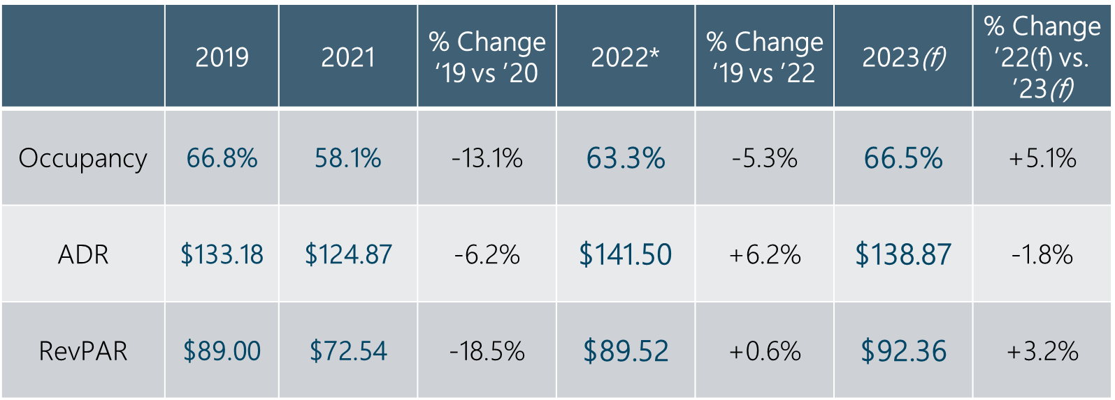
Guest Paid RevPAR Recovers in 2023: Occupancy is the Driver Total U.S. 2019, 2021, 2022 & 2023
*June YTD Actual
+ Forecast

Slide 18
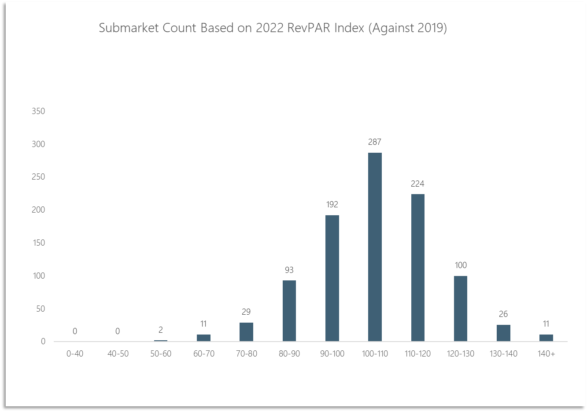




Distribution of 975 U.S. Submarkets 2022 vs. 2019 Guest Paid RevPAR Index
314

Slide 19
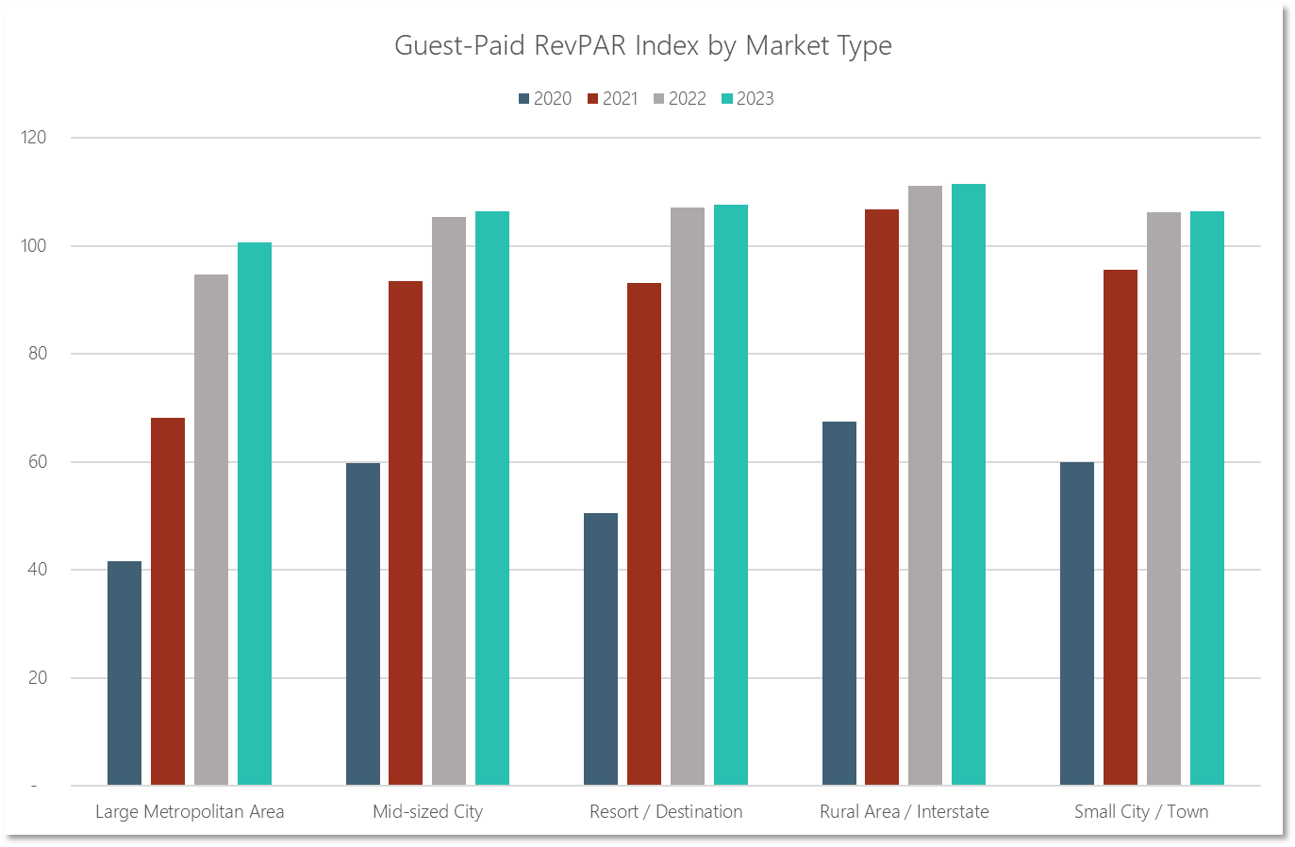


Total U.S. Guest Paid RevPAR Index by Market Type 2020-2023(f) vs. 2019
2019 RevPAR
Index=100

Slide 20
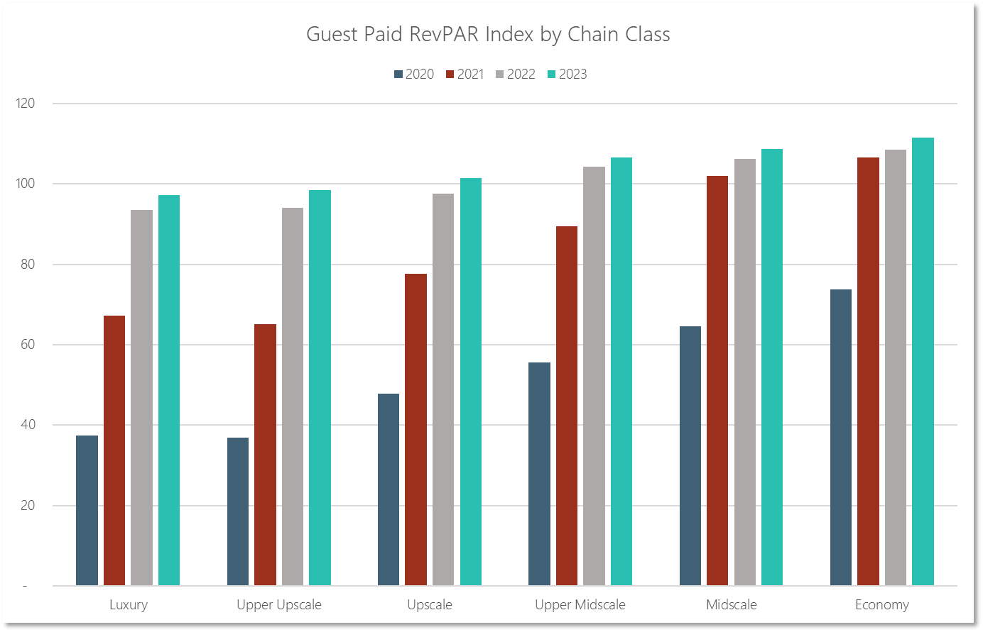
Total U.S. Guest Paid RevPAR Index by Chain Class 2020-2023(f) vs. 2019
Forecast
2019 RevPAR
Index=100
© 2022 Kalibri Labs | Reproduction or use is prohibited without prior written approval.

Slide 21
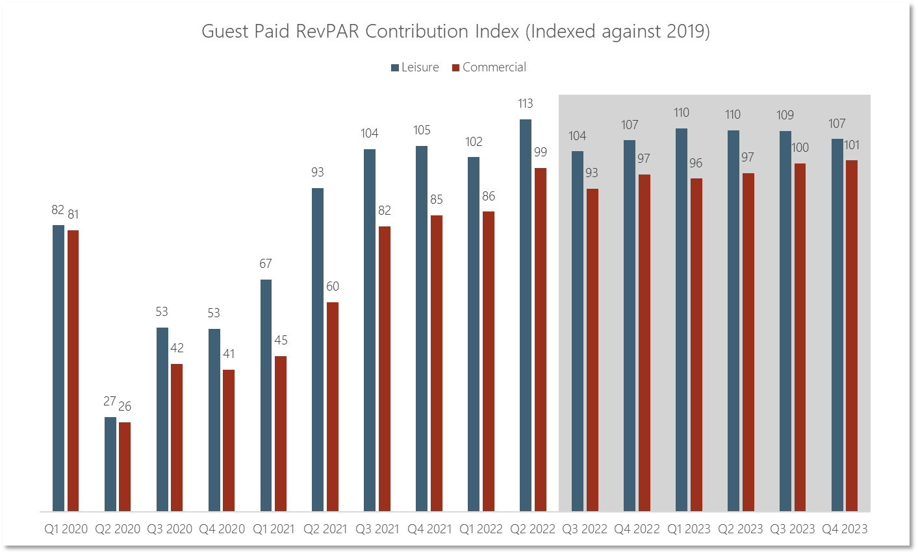

Total Guest Paid RevPAR Contribution – Commercial vs. Leisure 2020-2023(f) vs. 2019
Forecast

Slide 22

Summary
COVID Recovery and U.S. Business Mix
Performance varies widely by market—averages may be misleading
Dependence on Commercial is largest driver of recovery
All markets are getting some growth but lagging Group and limited Transient Corporate constrains large metro market recovery
Silver Linings
Longer length of stay is encouraging especially in mid- and lower-tier hotels
Uptick in shoulder periods (Sunday/Thursday) may be sustainable
Leisure has contributed more than its previous share in many markets
Healthy growth in ADR

